Slide 1
Kubernetes Basics

Slide 2
Orchestration of Containers
Container orchestration is a process of managing docker containers Lifecyle in production grade environments.
Using these tools we can easily manage multiple clustered containers deployments.
Using orchestration tools we can implement features like load balancing, auto scaling and failover.
There are two major orchestration tools available for Docker i.e. Kubernetes and Docker Swarm.
Notes:
Instructor notes:
In high and sensitive environment we have to use orchestration tools to manage docker containers. These docker containers can be easily deployed, replaced or even terminate across multiple clusters. We can even perform CI CD workflow by integrating orchestration tools within pipeline scripts.
With orchestration tool deployments and rollback are quiet easy with just one command itself. We don’t have to kill individuals containers and replace them with new containers.

Slide 3
Benefits of Orchestration of Containers
Below are some of the benefits of using Orchestration for Containers:
Scaling your containers easily
Service discovery and service management
Load Balancing across multiple containers for application
Container lifecycle management
Easy deployment rollback of containers across cluster
Notes:
Instructor notes:
Below are some of the benefits of using Orchestration for Containers:
Scaling your containers easily
Service discovery and service management
Load Balancing across multiple containers for application
Container lifecycle management
Easy deployment rollback of containers across cluster

Slide 4
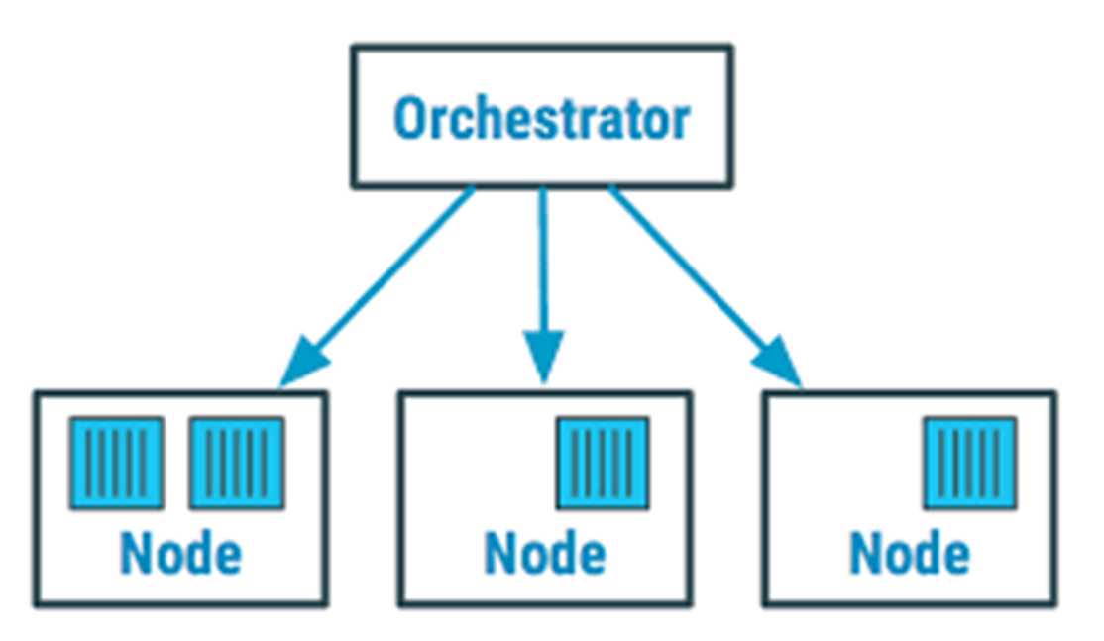
Docker Orchestration
Source: Devopedia
Notes:
Instructor notes:
In above diagram we could see common orchestration tool implementation. With this we have master node and other as client node. Using this master node it will try to manage containers across multiple nodes inside cluster. This master node is also known as manager who is responsible for managing complete lifecycle of a docker container.

Slide 5
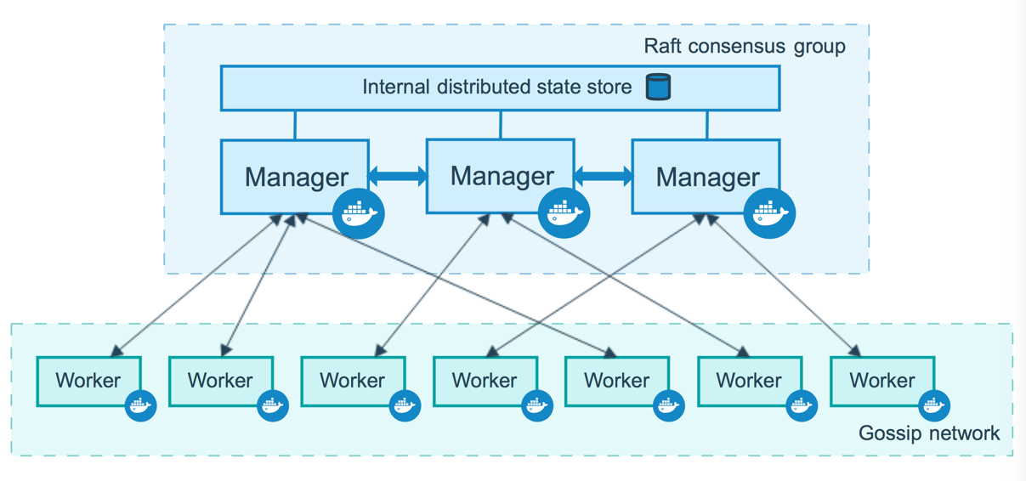
Docker Swarm
Source: Docker
Notes:
Instructor notes:
In above diagram we could see common orchestration tool implementation. With this we have master node and other as client node. Using this master node it will try to manage containers across multiple nodes inside cluster. This master node is also known as manager who is responsible for managing complete lifecycle of a docker container.

Slide 6
Kubernetes v/s Docker Swarm
Kubernetes
Docker Swarm
Cluster Installation is complicated.
Cluster Installation is Easy.
It supports GUI Dashboard
There is no GUI
Kubernetes can perform Auto Scaling
Auto Scaling not supported by Docker Swarm
Supports Rolling updates and Automated Rollbacks
Does not Supports automated Rollbacks
In built logging and monitoring
Can be integrated with ELK for logging and monitoring
Notes:
Instructor notes:

Slide 7
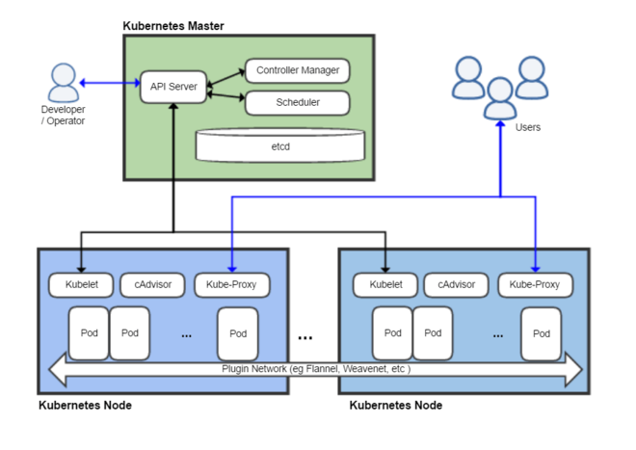
Kubernetes
Source: Wikipedia
Notes:
Instructor notes:

Slide 8
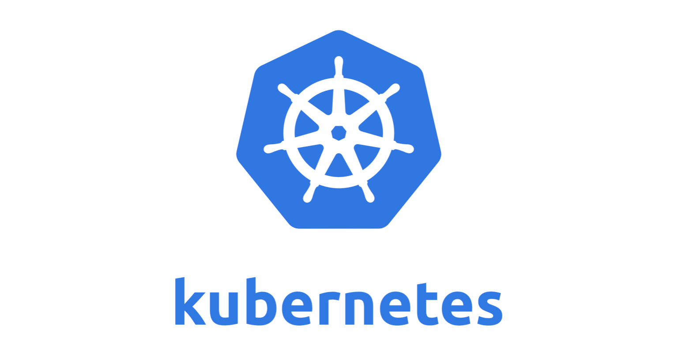
What is Kubernetes?
Notes:
Instructor notes:
Kubernetes also known as K8s is an open source tool used for managing, deploying and scaling Docker containers. First designed by Google, then handed over to Cloud Native Computing Foundation was first launched in 2014.
Kubernetes also uses master slave architecture, where we can add different nodes in the cluster. Most of the Cloud providers now provides PaaS based services to provide Kubernetes cluster.
Kubernetes is developed in Go language.

Slide 9
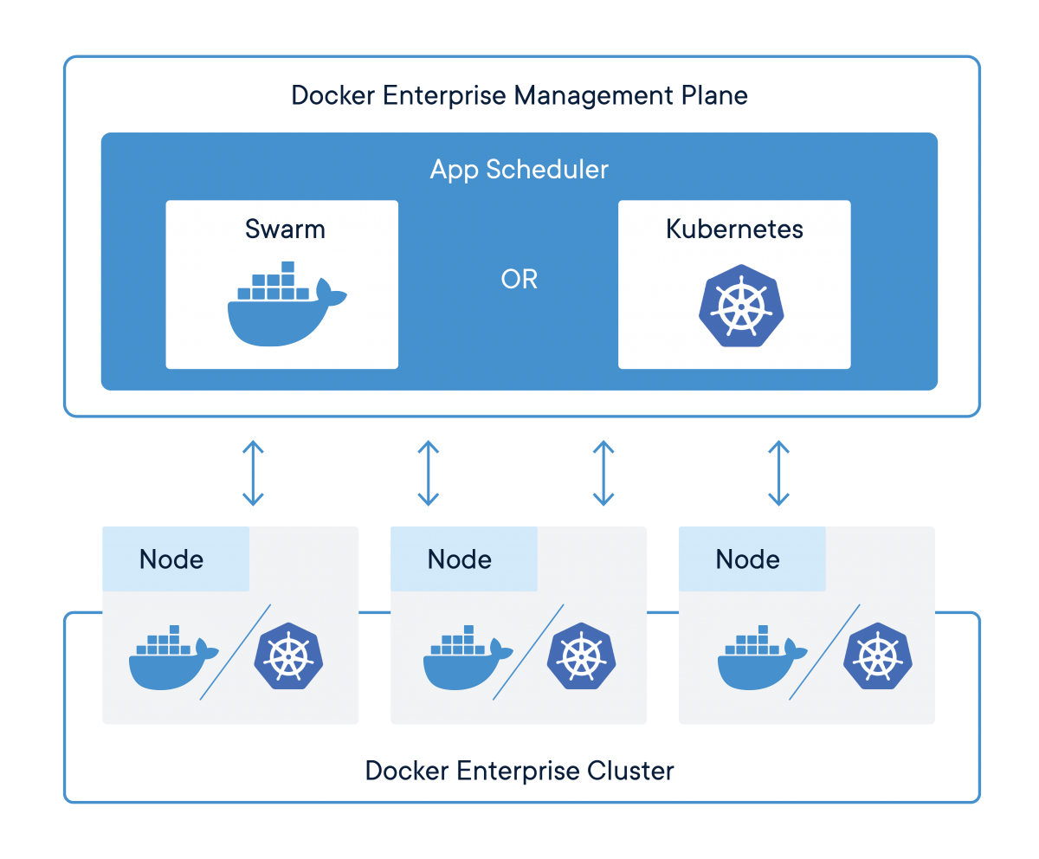
Relationship between Kubernetes and containers
Source: Docker
Notes:
Instructor notes:
Kubernetes mainly responsible for tasks like containers deployment, scaling, descaling, load balancing and high availability. There are cloud based services which helps us to provide Kubernetes as PaaS service. We can use these services to create cluster using AWS, GCP and Azure porta.
Kubernetes and Docker are both fundamentally different technologies but they work very well together, and both facilitate the management and deployment of containers in a distributed architecture.
Docker containers are managed using orchestration tools like Kubernetes. We can host production ready Docker containers using Kubernetes cluster.
Kubernetes assigns unique IP address so that we can access these containers from outside world.

Slide 10
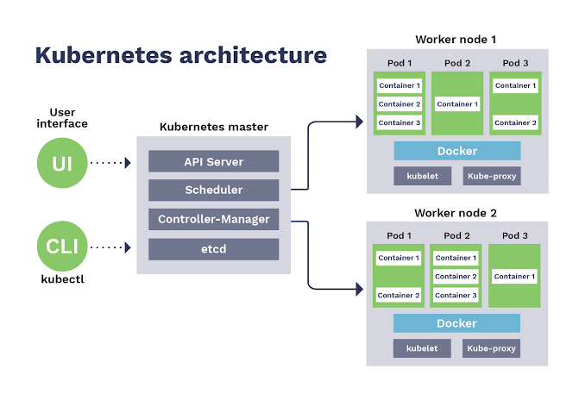
Kubernetes Architecture
Source: Sensu
Notes:
Instructor notes:
Kubernetes architecture components is distributed into two category as below:
Components for Master Machine
etcd
API Server
Scheduler
Controller Manager
Components for Slave Machine
Kubelet
cAdvisor
Pod
Kube-Proxy

Slide 11
Kubernetes Terminology
Pods : Basic scheduling unit in Kubernetes is known as Pod. Pod can have one or more containers deployed on Kubernetes cluster. Each Pod is allocated an unique IP address within cluster.
Labels and Selectors : Kubernetes uses key-pair values called labels to objects like Pods, Controller, Services etc. These Labels are very important to search for a specific resource in Kubernetes.
Controllers : Controllers are the main component of Kubernetes. These controllers are used to manage the overall functionality of Kubernetes. We are having various controllers like daemon controller, replica set controller and job controller. These controller will make sure containers are always up and running.
Services : Kubernetes service is a group of multiple container bundled up together. Each service is allocated a unique port which can be used to access a application. These services helps to implement features like load balancing and high availability.
Notes:
Instructor notes:
Pods : Basic scheduling unit in Kubernetes is known as Pod. Pod can have one or more containers deployed on Kubernetes cluster. Each Pod is allocated an unique IP address within cluster.
Labels and Selectors : Kubernetes uses key-pair values called labels to objects like Pods, Controller, Services etc. These Labels are very important to search for a specific resource in Kubernetes.
Controllers : Controllers are the main component of Kubernetes. These controllers are used to manage the overall functionality of Kubernetes. We are having various controllers like daemon controller, replica set controller and job controller. These controller will make sure containers are always up and running.
Services : Kubernetes service is a group of multiple container bundled up together. Each service is allocated a unique port which can be used to access a application. These services helps to implement features like load balancing and high availability.

Slide 12
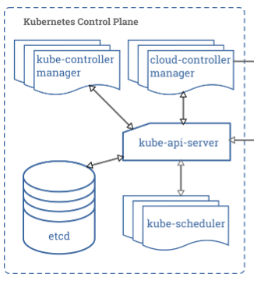
Kubernetes Master Components
Source: Kubernetes
Notes:
Instructor notes:
Kubernetes master components are deployed on same machine in the cluster. Master node is not configured by default to run user containers. Below are some of master components deployed:
etcd
API Server
Scheduler
Controller Manager

Slide 13
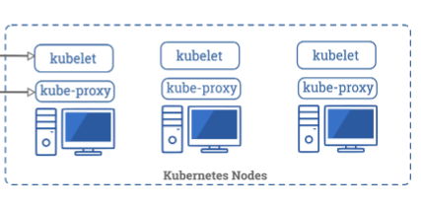
Kubernetes Node Components
Source: Kubernetes
Notes:
Instructor notes:
Kubernetes node components are used to deploy pods by Kubernetes master. Below are some of node components deployed:
Kubelet
cAdvisor
Pod
Kube-Proxy

Slide 14
YAML Templates
YAML, which stands for Yet Another Markup Language, or YAML Ain’t Markup Language (depending who you ask) is a human-readable text-based format for specifying configuration-type information.
YAML is a superset of JSON, so any valid JSON can be easily converted in YAML format.
There are only two types of structures you need to know about in YAML:
Lists
Maps
Notes:
Instructor notes:
YAML, which stands for Yet Another Markup Language, or YAML Ain’t Markup Language (depending who you ask) is a human-readable text-based format for specifying configuration-type information.
YAML is a superset of JSON, so any valid JSON can be easily converted in YAML format.
There are only two types of structures you need to know about in YAML:
Lists
Maps

Slide 15
YAML Benefits
Using YAML for K8s definitions offers you a number of advantages, list as below:
Convenience: You don’t have to put all different parameters in command line interface.
Maintenance: YAML files can be versioned in version control system, which can be easily modified by respective users.
Flexibility: You’ll be able to create much more complex structures using YAML than you can on the command line.
Notes:
Instructor notes:
Using YAML for K8s definitions offers you a number of advantages, list as below:
Convenience: You don’t have to put all different parameters in command line interface.
Maintenance: YAML files can be versioned in version control system, which can be easily modified by respective users.
Flexibility: You’ll be able to create much more complex structures using YAML than you can on the command line.

Slide 16
Imperative Management of Kubernetes Objects
Imperative commands are used to manage Kubernetes objects directly with kubectl command as arguments or flags.
This is one of the simple way to deploy pods, deployment and services.
We can manage complete Kubernetes cluster using kubectl command line.
Examples
Run an instance of the nginx container by creating a Deployment object:
kubectl run nginx --image nginx
Notes:
Instructor notes:
Imperative commands are used to manage Kubernetes objects directly with kubectl command as arguments or flags.
This is one of the simple way to deploy pods, deployment and services. We can manage complete Kubernetes cluster using kubectl command line.
Examples
Run an instance of the nginx container by creating a Deployment object:
kubectl run nginx --image nginx

Slide 17
Declarative Management of Kubernetes Objects
With declarative object management, admins can manage Kubernetes objects using configuration files stored locally.
Users can configure objects configurations like Create, update, and delete operations using YAML templates.
Kubernetes objects can be created, updated, and deleted by executing kubectl apply on these configuration files.
Example:
kubectl apply -f myapp-deployment.yaml
Notes:
Instructor notes:
With declarative object management, admins can manage Kubernetes objects using configuration files stored locally. Users can configure objects configurations like Create, update, and delete operations using YAML templates.
Kubernetes objects can be created, updated, and deleted by executing kubectl apply on these configuration files.
Example:
kubectl apply -f myapp-deployment.yaml

Slide 18
Kubernetes Labels and Selectors
Kubernetes attaches key-value pairs called labels for various objects such as services, pods, and nodes.
These labels can be used to locate a specific resource
Same label can be used for multiple objects, so you should define and create unique labels for Kubernetes objects
Labels: Selectors:
apiVersion: v1 spec:
kind: Pod selector:
metadata: matchLabels:
name: example-pod app: springpeople
labels:
env: development
Notes:
Instructor notes:
Kubernetes attaches key-value pairs called labels for various objects such as services, pods, and nodes. These labels can be used to locate a specific resource
Same label can be used for multiple objects, so you should define and create unique labels for Kubernetes objects
Labels: Selectors:
apiVersion: v1 spec:
kind: Pod selector:
metadata: matchLabels:
name: example-pod app: springpeople
labels:
env: development

Slide 19
Kubernetes Namespace
Namespace acts like a virtual cluster on Kubernetes Cluster.
We can have multiple namespaces on a cluster and resources created in these namespaces will be totally isolated from each other.
We should not use namespaces for isolating resources, we can use labels and selectors for that.
Kubernetes provides mainly three namespaces once initialized on server
default: Used by default to deploy resources on Kubernetes
kube-public Public namespace for hosting public resources
kube-system Used by Kubernetes for internal components
Notes:
Instructor notes:
Namespace acts like a virtual cluster on Kubernetes Cluster.
We can have multiple namespaces on a cluster and resources created in these namespaces will be totally isolated from each other.
We should not use namespaces for isolating resources, we can use labels and selectors for that.
Kubernetes provides mainly three namespaces once initialized on server
default: Used by default to deploy resources on Kubernetes
kube-public Public namespace for hosting public resources
kube-system Used by Kubernetes for internal components

Slide 20
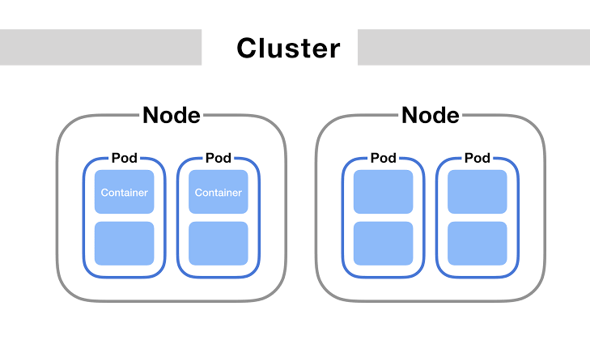
Kubernetes Pod
Notes:
Instructor notes:
Pod templates are pod specifications which are included in other objects, such as Replication Controllers, Jobs, and DaemonSets. Controllers use Pod Templates to make actual pods. The sample below is a simple manifest for a Pod which contains a container that prints a message.
if a Node fails, the Controller might automatically replace the Pod by scheduling an identical replacement on a different Node.

Slide 21
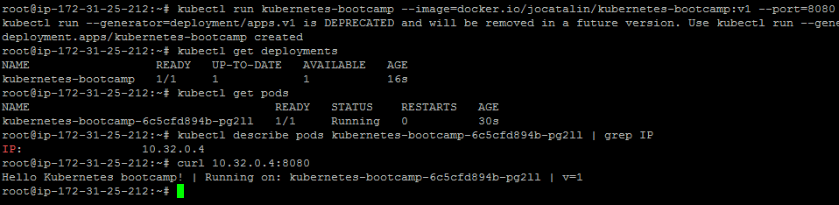
Kubernetes Pod Setup
Notes:
Instructor notes:
Now once Kubernetes cluster is started we can create a sample pod to understand the complete workflow. Use the below commands to create deployment in Kubernetes and then try to access application deployed in Container.
kubectl run <deployment name> --image=docker.io/<docker image>:<tag> --port=<docker container port>
Example:
kubectl run kubernetes-bootcamp --image=docker.io/jocatalin/kubernetes-bootcamp:v1 --port=8080
kubectl get deployments To get the list of Docker images deployed to Kubernetes
kubectl get pods List of pods running on Kubernetes Cluster

Slide 22
Pod Template
apiVersion: v1
kind: Pod
metadata:
name: app-pod
labels:
app: app
spec:
containers:
- name: app-container
image: jenkins
Notes:
Instructor notes:
As per above we could see Pod template which can be used to create pods with one or multiple containers. We need to execute blow command to deploy resources as part of
kubectl apply -f pod-deployment.yaml

Slide 23
Deployment Template
apiVersion: apps/v1
kind: Deployment
metadata:
name: app-deployment
spec:
selector:
matchLabels:
app: app
template:
metadata:
labels:
app: app
spec:
containers:
- name: app-container
image: nginx
Notes:
Instructor notes:
As per above we could see Deployment template which can be used to create deployment Kubernetes object on cluster. We need to execute blow command to deploy resources as part of
kubectl apply -f deployment.yaml

Slide 24
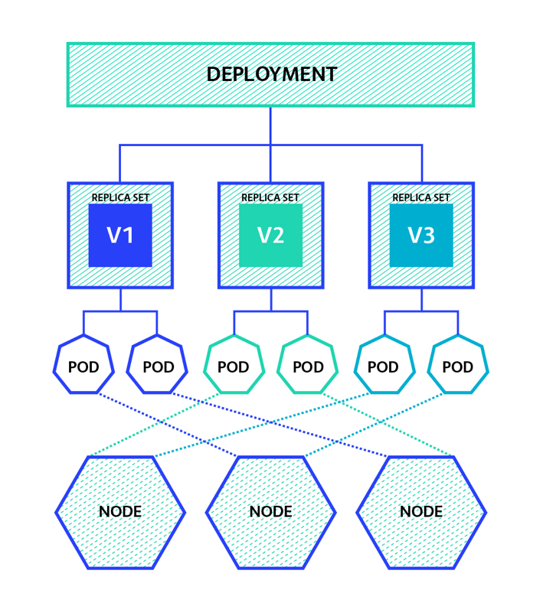
Kubernetes Replica Set
Notes:
Instructor notes:
Kubernetes replica sets helps us to maintain the number of replicas of pod in cluster. Replica Sets ensures that a specified number of pods are always running for a specific application.
In case a pod terminates replica sets ensures to bring a new fresh pod in place of terminated one. We can anytime increase and decrease the number of replica sets for a specific deployment in cluster.
Replica sets also helps us to scale up and scale down the services.
Example:
kubectl scale deployments/<deployment name> --replicas=<replica set number>

Slide 25
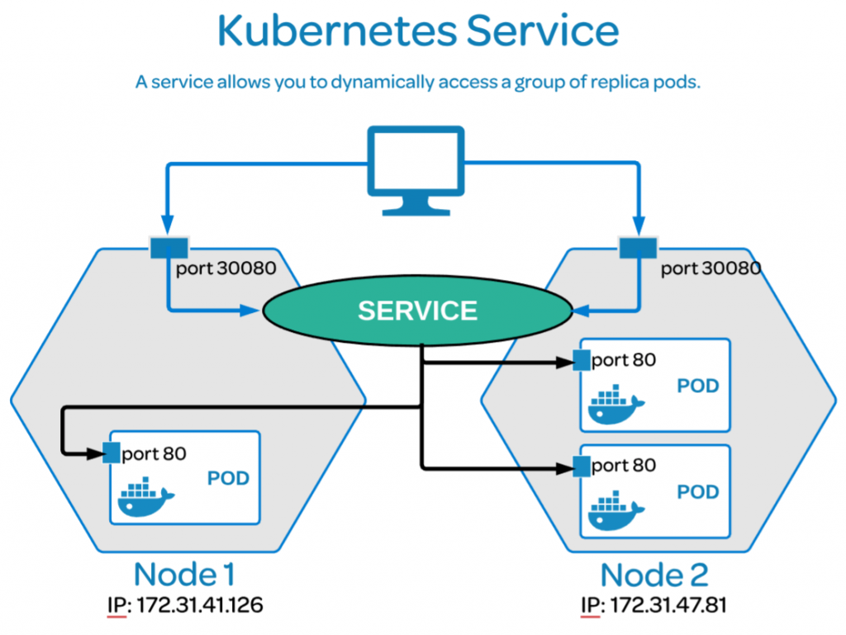
Kubernetes Services
Notes:
Instructor notes:
Once Kubernetes pod is initialized we can expose it in form of service so that we can get a dedicated port. Using this port we can access application from outside world also. Follow below sequence to expose any deployment and make it accessible from outside.
kubectl expose deployment/<deployment name> --port=<app port> --target-port=<app port> --type=NodePort
Example:
kubectl expose deployment/kubernetes-bootcamp --port=8080 --target-port=8080 --type=NodePort

Slide 26
Services Template
apiVersion: v1
kind: Service
metadata:
name: app-nginx
labels:
run: app-nginx
spec:
ports:
- port: 80
protocol: TCP
selector:
run: app-nginx
type: NodePort
Notes:
Instructor notes:
As per above we could see services template which can be used to expose containers and assign dedicated port to Kubernetes pod. We need to execute blow command to deploy resources as part of above YAML template.
kubectl apply -f service.yaml

Slide 27
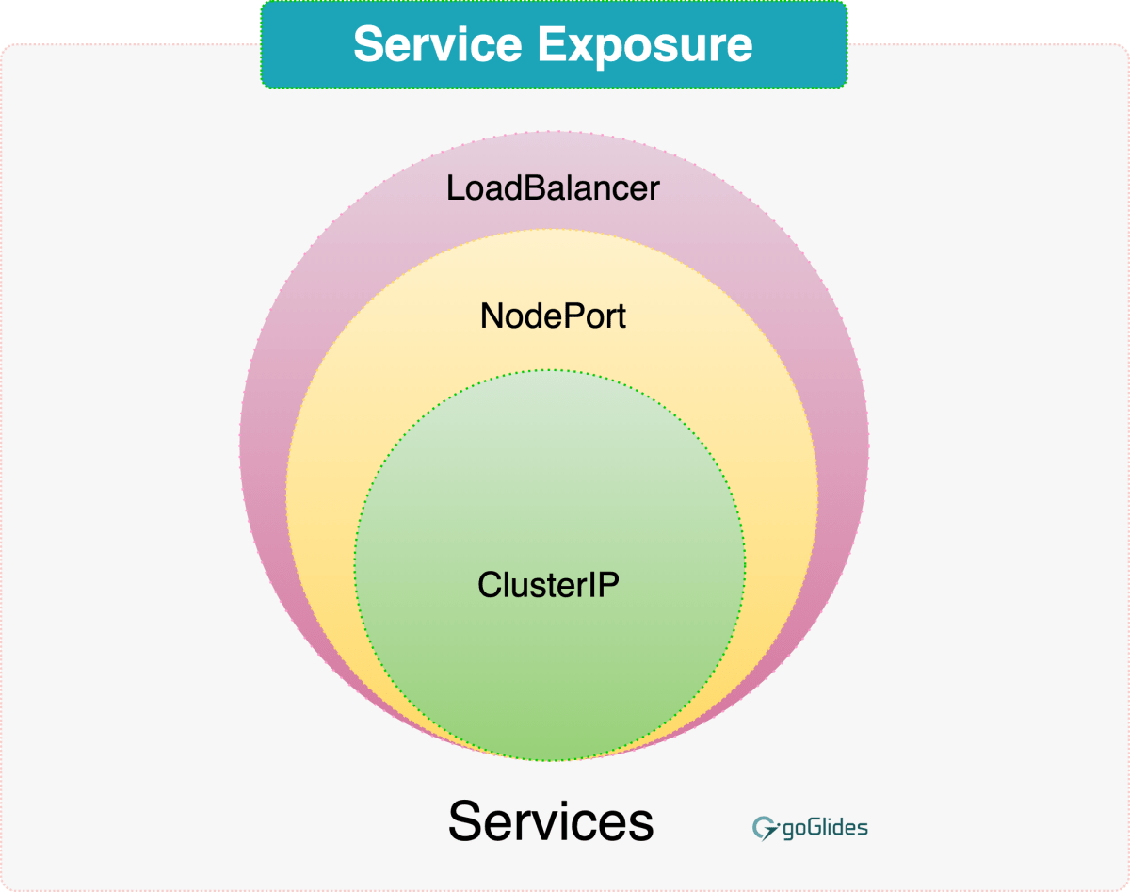
Kubernetes Services Types
Notes:
Instructor notes:
Kubernetes Service can be created using below commands:
kubectl apply -f service.yaml Deploy service object on cluster
kubectl get svc Fetch services on Kubernetes Cluster

Slide 28
Services Type
While deploying service on Kubernetes we can specify what kind of service we want to configure. We are having below three Types of service:
ClusterIP: Exposes the Service on a cluster-internal IP. Choosing this value makes the Service only reachable from within the cluster. This is the default ServiceType.
NodePort: Exposes the Service on each Node’s IP at a static port. We will be able to access application from outside cluster using <NodeIP>:<NodePort>.
LoadBalancer: We can expose a service using a cloud provider’s load balancer. Kubernetes will create a NodePort which will redirect traffic to load balancers.
Notes:
Instructor notes:
While deploying service on Kubernetes we can specify what kind of service we want to configure. We are having below three Types of service:
ClusterIP: Exposes the Service on a cluster-internal IP. Choosing this value makes the Service only reachable from within the cluster. This is the default ServiceType.
NodePort: Exposes the Service on each Node’s IP at a static port. We will be able to access application from outside cluster using <NodeIP>:<NodePort>.
LoadBalancer: We can expose a service using a cloud provider’s load balancer. Kubernetes will create a NodePort which will redirect traffic to load balancers.

Slide 29
Cluster IP Template
apiVersion: v1
kind: Service
metadata:
name: nginx-service
spec:
selector:
app: nginx-pod
ports:
- name: http
port: 8080
type: ClusterIP
Notes:
Instructor notes:
We can use service template as per below using which we will be able to create service of ClusterIP Type.
apiVersion: v1
kind: Service
metadata:
name: nginx-service
spec:
selector:
app: nginx-pod
ports:
- name: http
port: 8080
type: ClusterIP

Slide 30
NodePort Template
apiVersion: v1
kind: Service
metadata:
name: nginx-service
spec:
selector:
app: nginx-pod
ports:
- name: http
port: 8080
type: NodePort
Notes:
Instructor notes:
We can use service template as per below using which we will be able to create service of ClusterIP Type.
apiVersion: v1
kind: Service
metadata:
name: nginx-service
spec:
selector:
app: nginx-pod
ports:
- name: http
port: 8080
type: NodePort

Slide 31
Load Balancer Template
apiVersion: v1
kind: Service
metadata:
name: nginx-service
spec:
selector:
app: nginx-pod
ports:
- name: http
port: 8080
type: LoadBalancer
Notes:
Instructor notes:
We can use service template as per below using which we will be able to create service of ClusterIP Type.
apiVersion: v1
kind: Service
metadata:
name: nginx-service
spec:
selector:
app: nginx-pod
ports:
- name: http
port: 8080
type: LoadBalancer

Slide 32
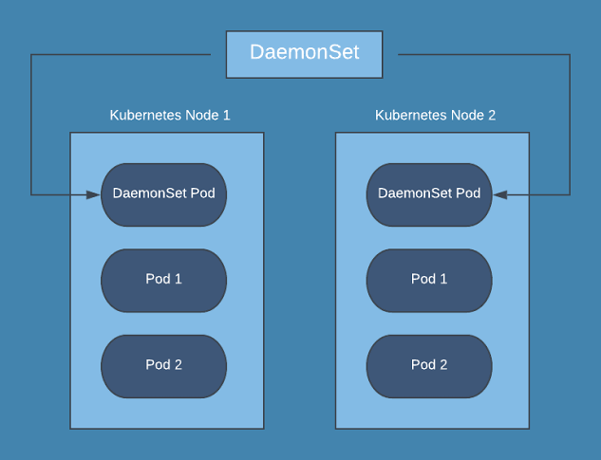
Daemon Sets
Notes:
Instructor notes:
A Kubernetes DaemonSet ensures that all nodes run a specific pod configured as part of DaemonSet configuration. When a new node is added to cluster, a new pod will be created and when that node is removed, those Pods are garbage collected. Deleting a DaemonSet will clean up the Pods it created.
We can usually deploy containers for collecting logs, metrics or for monitoring purposes. Some of common tools which can be deployed are such as logstash, Prometheus Node Exporter, datadog agent or collectd.

Slide 33
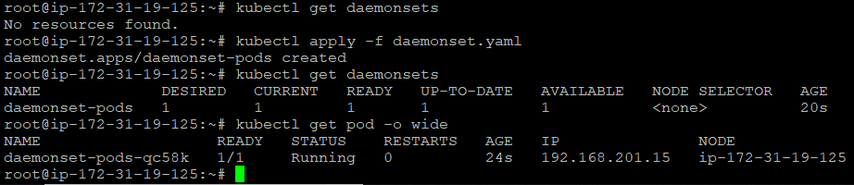
Daemon Sets
Notes:
Instructor notes:
We can create DaemonSet on Kubernetes Cluster using below template:
apiVersion: apps/v1
kind: DaemonSet
metadata:
name: daemonset-pods
spec:
selector:
matchLabels:
name: daemonset-pods
template:
metadata:
labels:
name: daemonset-pods
spec:
containers:
- name: daemon-container
image: httpd:latest
ports:
- containerPort: 80
Now we can run below commands to setup daemon set
kubectl get daemonsets Fetch Daemon sets on Kubernetes Cluster
kubectl apply -f daemonset.yaml
kubectl get daemonsets
kubectl get pod -o wide

Slide 34
Kubernetes Volume
apiVersion: v1
kind: Pod
metadata:
name: redis
spec:
containers:
- name: redis
image: redis
volumeMounts:
- name: redis-storage
mountPath: /data/redis
volumes:
- name: redis-storage
emptyDir: {}
Notes:
Instructor notes:
This Pod has a Volume of type emptyDir that lasts for the life of the Pod, even if the Container terminates and restarts. Below is the configuration file to create pod with persistant volume:
pods/storage/redis.yaml
apiVersion: v1
kind: Pod
metadata:
name: redis
spec:
containers:
- name: redis
image: redis
volumeMounts:
- name: redis-storage
mountPath: /data/redis
volumes:
- name: redis-storage
emptyDir: {}

Slide 35
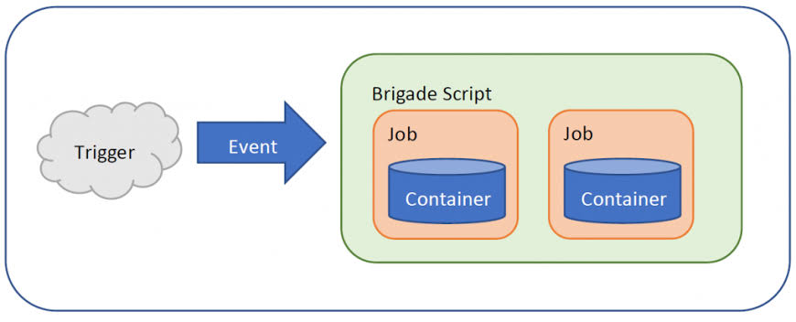
Kubernetes Jobs
Source: Microsoft
Notes:
Instructor notes:
A job in Kubernetes is a supervisor for pods carrying out batch processes, that is, a process that runs for a certain time to completion, for example a calculation or a backup operation.
The main function of a job is to create one or more pod and tracks about the success of pods. They ensure that the specified number of pods are completed successfully. When a specified number of successful run of pods is completed, then the job is considered complete.

Slide 36
Kubernetes Jobs
apiVersion: batch/v1
kind: Job
metadata:
name: countdown
spec:
template:
metadata:
name: countdown
spec:
containers:
- name: counter
image: centos:7
command:
- "bin/bash"
- "-c"
- "for i in 9 8 7 6 5 4 3 2 1 ; do echo $i ; done"
restartPolicy: Never
Notes:
Instructor notes:
A Job creates one or more Pods and ensures that a specified number of them successfully terminate. As pods successfully complete, the Job tracks the successful completions. When a specified number of successful completions is reached, the task (ie, Job) is complete. Deleting a Job will clean up the Pods it created.
Below is the Kubernetes job configuration:
apiVersion: batch/v1
kind: Job
metadata:
name: countdown
spec:
template:
metadata:
name: countdown
spec:
containers:
- name: counter
image: centos:7
command:
- "bin/bash"
- "-c"
- "for i in 9 8 7 6 5 4 3 2 1 ; do echo $i ; done"
restartPolicy: Never

Slide 37
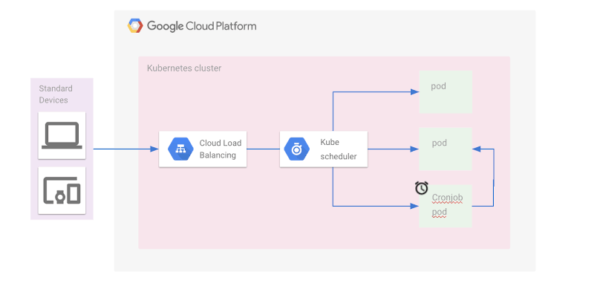
Kubernetes CronJobs
Source: Medium
Notes:
Instructor notes:
You can use a CronJob to run Jobs on a time-based schedule. These automated jobs run like Cron tasks on a Linux or UNIX system.
Cron jobs are useful for creating periodic and recurring tasks, like running backups or sending emails. Cron jobs can also schedule individual tasks for a specific time, such as if you want to schedule a job for a low activity period.

Slide 38
Kubernetes CronJobs
apiVersion: batch/v1beta1
kind: CronJob
metadata:
name: counterwebapp
spec:
schedule: "*/1 * * * *"
jobTemplate:
spec:
template:
spec:
containers:
- name: counterwebapp
image: busybox
args:
- /bin/sh
- -c
- date; echo Hello from the Kubernetes cluster
restartPolicy: OnFailure
Notes:
Instructor notes:
For every CronJob, the CronJob Controller checks how many schedules it missed in the duration from its last scheduled time until now.
Below is the Kubernetes job configuration:
apiVersion: batch/v1beta1
kind: CronJob
metadata:
name: springpeople
spec:
schedule: "*/1 * * * *"
jobTemplate:
spec:
template:
spec:
containers:
- name: springpeople
image: busybox
args:
- /bin/sh
- -c
- date; echo Hello from the Kubernetes cluster
restartPolicy: OnFailure

Slide 39
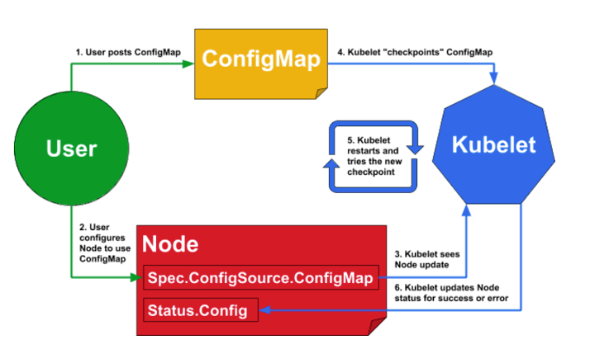
Kubernetes configMap
Source: configMaps
Notes:
Instructor notes:
ConfigMaps allow you to decouple configuration artifacts from image content to keep containerized applications portable. A ConfigMap stores configuration settings for your code. Store connection strings, public credentials, hostnames, and URLs in your ConfigMap.
We can use configMaps to separate configuration settings from application source code.
apiVersion: v1
metadata:
name: configmap
data:
springpeople: value
kind: ConfigMap

Slide 40
Kubernetes configMap
apiVersion: v1
kind: Pod
metadata:
name: configmap-pod
spec:
containers:
- name: configmap-container
image: alpine
command: [ "/bin/sh", "-c", "env" ]
env:
- name: ENV_KEY
valueFrom:
configMapKeyRef:
name: configmap
key: springpeople
restartPolicy: Never
Notes:
Instructor notes:
We can create pod configuration with configMaps to load environment variables in Kubernetes containers.
apiVersion: v1
kind: Pod
metadata:
name: configmap-pod
spec:
containers:
- name: springpeople-container
image: alpine
command: [ "/bin/sh", "-c", "env" ]
env:
- name: ENV_KEY
valueFrom:
configMapKeyRef:
name: configmap
key: springpeople
restartPolicy: Never

Slide 41
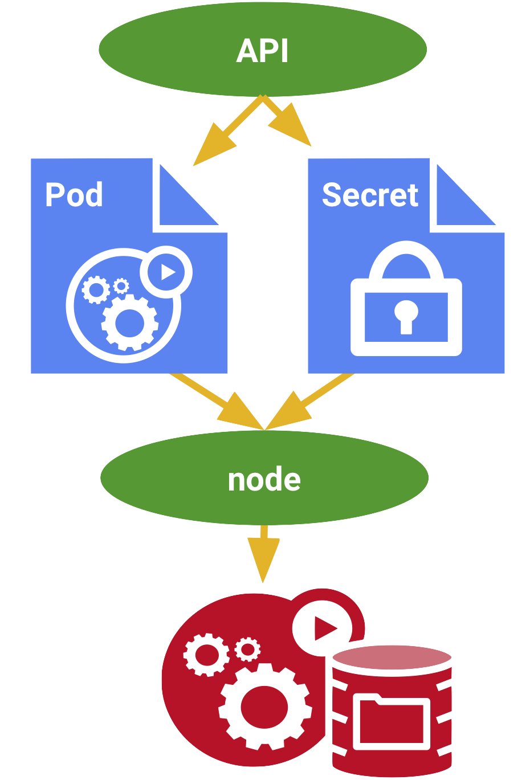
Kubernetes Secrets
Source: Google Cloud
Notes:
Instructor notes:
Kubernetes secret objects let you store and manage sensitive information, such as passwords, OAuth tokens, and ssh keys. Putting this information in a secret is safer and more flexible than putting it verbatim in a Pod definition or in a container image.
We can use secrets as per below Kubernetes configuration YAML file.
apiVersion: v1
kind: Secret
metadata:
name: tomcat-pass
type: Opaque
data:
password: <User Password>
username: <User Name>

Slide 42
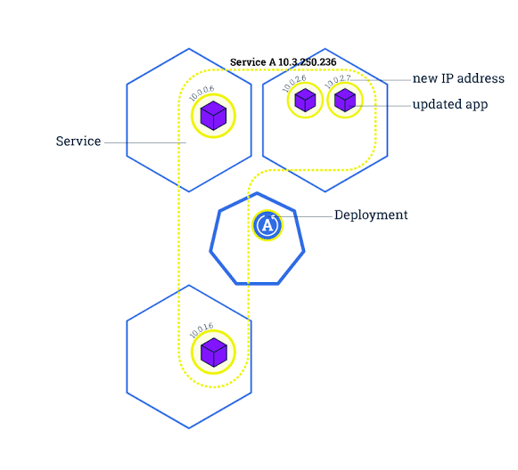
Kubernetes Rolling Update
Notes:
Instructor notes:
To update a service without an outage, kubectl supports what is called rolling update, which updates one pod at a time, rather than taking down the entire service at the same time.
A rolling update applies changes to the configuration of pods being managed by a replication controller. The changes can be passed as a new replication controller configuration file; or, if only updating the image, a new container image can be specified directly.

Slide 43
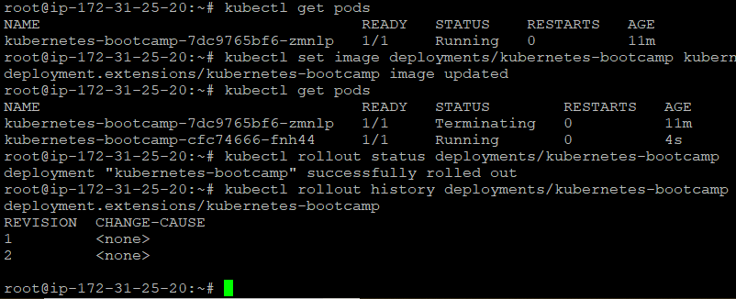
Kubernetes Rolling Update
Notes:
Instructor notes:
We can follow set of commands using which we can roll out new changes to our Kubernetes pods.
kubectl set image deployments/kubernetes-bootcamp kubernetes-bootcamp=jocatalin/kubernetes-bootcamp:v2 Sets up new docker image to pod
kubectl get pods Fetch Kubernetes Pods
kubectl rollout status deployments/kubernetes-bootcamp Kubernetes Roll out status
kubectl rollout history deployments/kubernetes-bootcamp Kubernetes Roll out history

Slide 44
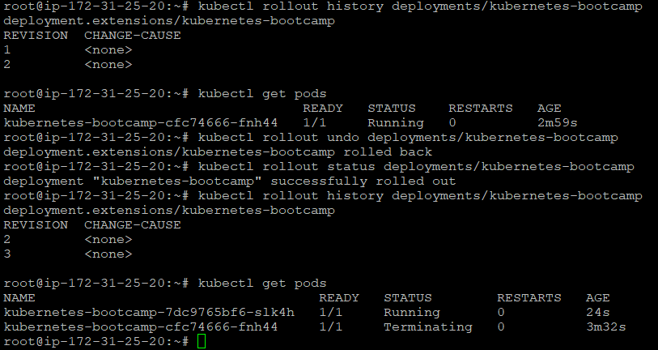
Kubernetes Roll Back
Notes:
Instructor notes:
We can follow set of commands using which we can roll back our changes to our Kubernetes pods. We don’t have to remember previous version, Kubernetes will automatically rollback recent changes.
kubectl rollout undo deployments/kubernetes-bootcamp Undo rollout changes
kubectl rollout status deployments/kubernetes-bootcamp Rollout status for pods
kubectl rollout history deployments/kubernetes-bootcamp Rollout history for Kubernetes deployment
kubectl get pods

Slide 45
CPU & Memory Reservations
When you specify a Pod, you can optionally specify how much CPU and memory (RAM) each Container needs.
When Containers have resource requests specified, the scheduler can make better decisions about which nodes to place Pods on.
And when Containers have their limits specified, contention for resources on a node can be handled in a specified manner.
CPU is specified in units of cores, and memory is specified in units of bytes.
Notes:
Instructor notes:
When you specify a Pod, you can optionally specify how much CPU and memory (RAM) each Container needs. When Containers have resource requests specified, the scheduler can make better decisions about which nodes to place Pods on.
And when Containers have their limits specified, contention for resources on a node can be handled in a specified manner. CPU is specified in units of cores, and memory is specified in units of bytes.

Slide 46
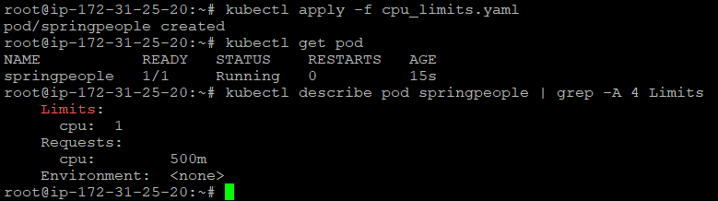
CPU Reservations Template
Notes:
Instructor notes:
To specify a CPU request for a container, include the resources:requests field in the Container resource manifest. To specify a CPU limit, include resources:limits.
We can specify these reservations as per below template:
apiVersion: v1
kind: Pod
metadata:
name: springpeople
spec:
containers:
- name: springpeople-containr
image: jenkins
resources:
limits:
cpu: "1"
requests:
cpu: "0.5"

Slide 47
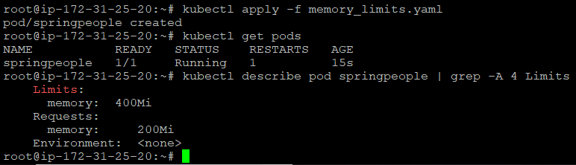
Memory Reservations Template
Notes:
Instructor notes:
To specify a memory request for a Container, include the resources:requests field in the Container’s resource manifest. To specify a memory limit, include resources:limits.
We can specify these reservations as per below template:
apiVersion: v1
kind: Pod
metadata:
name: springpeople
spec:
containers:
- name: springpeople-containr
image: jenkins
resources:
limits:
memory: "400Mi"
requests:
memory: "200Mi"

Slide 48
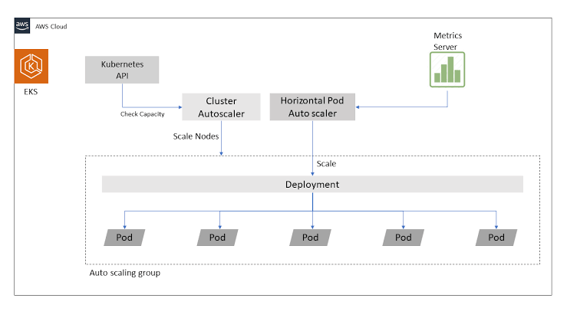
Kubernetes Autoscaling
Source: Medium
Notes:
Instructor notes:
Autoscaling is one of the key features in Kubernetes cluster. It is a feature in which the cluster is capable of increasing the number of nodes as the demand for service response increases and decrease the number of nodes as the requirement decreases.
We can run below command to setup autoscaling for a specific application depending on CPU utilization.
kubectl autoscale deployment <Application Name> --cpu-percent = 50 --min = 1 -- max = 10

Slide 49
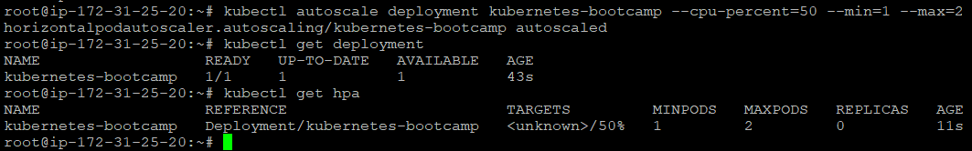
Kubernetes Autoscaling
Notes:
Instructor notes:
We can run below command to setup autoscaling for a specific application depending on CPU utilization.
kubectl autoscale deployment <Application Name> --cpu-percent=50 --min=1 --max =10
--min represents minimum number of pods to be up and running
--max represents maximum number of pods in autoscaling

